Slide 1

Accurate data classification using Exact Data Matching Part 2
Enrique Saggese
Principal Program Manager, CxE
Microsoft Purview
Information Protection and Compliance
Microsoft Corp.

Slide 2
Agenda
What is EDM
EDM under the hood
How to configure EDM
EDM in specific industries
Tips, tricks and advanced techniques for deploying EDM
Sneak peek: the new EDM wizard

Slide 3
What is exact data matching

Slide 4
Data classification in the Microsoft Purview architecture

Slide 5
Sensitive information classifiers in Microsoft Purview
Detection of sensitive content can be done using a multitude of mechanisms:
Built-in sensitive information types in Microsoft 365 (200+)
Custom sensitive information types
Using regular expressions
Using predefined functions
Keyword dictionaries
Keyword lists
Combinations of those (e.g. main criteria plus additional evidence requirements) and built-in validators
Trainable classifiers
Pre-trained ML classifiers (40+)
Named entity recognition
Exact data matching
Form fingerprinting (for email attachments)
More coming (e.g. Advanced fingerprinting, OCR)
Humans are also good at detecting sensitive content
Manually applied labels are also a form of classification
But humans are lazy

Slide 6
False positives vs. false negatives
A false positive is when content matches a rule you would not expect to match.
Two kinds of false positives:
Classifier match false positive: the SIT (or other classifier) detects content that is not what you expect.
E.g. your company has a part # in the form nnn-nn-nnnn in a product that includes the letters “SSN” in its name, which causes such part numbers to be flagged as US Social Security Numbers even though they aren’t.
Functional false positive: The SIT detected pieces of information that are of the desired type, but not relevant.
E.g. you have a DLP rule to block sharing of PII, and it fires when someone shares their own SSN with their tax advisor.
A false negative is when you miss detecting something you should have

Slide 7

The costs of false positives
Business disruption: users are prevented from performing legitimate actions
IT overload: too many alerts take too much time to review and assess.
Missing the needle in the haystack: too many matches or too many alerts make you dismiss the important ones.
Increase in false negatives: to offset FPs you make your rules less sensitive, which results in false negatives.
“A false positive can ruin my lunch, but a false negative can ruin my career”
- a concerned admin

Slide 8
Classifier vs classifier: how they compare
Note: there are other fundamental differences between classifier types, so this is not an apples to apples comparison

Slide 9
So EDM is better, right?
Sometimes. EDM is useful for identification and protection of sensitive info about *known subjects*, e.g.:
Customer data (PII)
Employee data (PII, PHI, employment info, performance data)
Patient data (PHI)
Device info (e.g. subscriber device, servers and equipment)
Customer affinity program data
Population PII (in government organizations)
Customer account data (e.g. account IDs)
And many more
EDM can’t be used for “general” PII (e.g. not your customers). You need to have a source for what you want to detect.
Markets with highest adoption:
Health care providers
Health care payors
Insurance
Financial services
Retail
Hospitality and travel
Consumer services
HR in a variety of markets
Professional services
Notes:
1

Slide 10
Where you can use EDM
Data loss Prevention
Exchange, SharePoint, OneDrive, Teams chat and Endpoint DLP policies.
Microsoft Cloud App Security DLP - for third party cloud apps.
Auto labeling
Auto apply a sensitivity label in SharePoint and OneDrive data at rest
Auto apply a sensitivity label in Exchange Online to data in transit
Client-side autolabeling in Office apps
Data discovery in Content Explorer
Coming soon:
Advanced eDiscovery
Insider risk management
Notes:
1

Slide 11
How EDM works

Slide 12
Requirements for EDM
A table with one or more columns of data for each subject
Data must be “clean” (i.e. more or less consistently formatted and complete)
You must be able to export the data to a comma, tab or pipe separated text file
You *do not* need to supply that data to Microsoft or upload it to your tenant
Run some tools on the data
Hash and upload process explained later
Privileges
Must have tenant or compliance admin privileges to configure EDM
Updating the data doesn’t require that privilege, can be controlled via special group
Licensing
Microsoft 365 E5
Microsoft 365 Information Protection and Compliance
Office 365 Advanced Compliance
Notes:
2

Slide 13
EDM at work
Find potential matches
Verify they match actual values
Check the surrounding text for a combination of those elements
Using regex, dictionaries, Named Entities or other SIT types
I.e. check against a list of actual customer PII
Retrieve other attributes for the same subject
E.g. That person’s name, phone #, date of birth, account #
Flag an EDM match if the conditions are met
E.g. SSN plus one of name, phone #, email address, account number
Notes:
2

Slide 14
What’s in an EDM configuration
EDM Schemas (up to 10 per tenant)
Definition of what columns compose the sensitive data and their propeties
Up to 32 columns, up to 5 searchable
EDM datastores (one per schema)
A table of *hashes* of sensitive data to use for lookups
100M rows max (not enforced, actual limit is 500M total cells)
EDM SITs (no limit, can be multiple per schema)
One or more “patterns” per SIT
Based on a regular SIT, but with a lookup on a column in the datastore to refine matches.
Can include a single condition (column) or also additional evidence (content matching multiple columns for the same row).
Notes:
2

Slide 15
Detour: why do we have to identify “potential” matches?
Can’t we just check everything for an exact match?
We could, but it would be computationally impractical and slow.
A match can be a word or number, multiple words, part of a word, etc.. Each document contains (n²+n)/2 sequences of strings inside (not counting ignored delimiters or casing)
If your company has 50,000 employees producing 100 pieces of content (email or document) per second, each with 500 words, that is equivalent to three quintillion strings to check per day.
If your table has 100 million rows and ten columns to check against each… you get the idea.
But can’t you optimize it? Not all sequences make sense!
That’s what we did: you tell us (via a SIT) what’s a meaningful string to check.
Notes:
2

Slide 16
Anatomy of an EDM SIT
Notes:
3

Slide 17
Anatomy of an EDM SIT: example
Notes:
3

Slide 18
About the sensitive info table
For EDM to work we *must* be able to check candidate matches against your data.
But we don’t need your data!!!!
We can use this little trick called hashing
A hash is a non-reversible but quasi unique transformation of a string:
E.g.:
The cat in the hat => 7a652063617374e0696e207468f52f68617
The cat in the hut => bb2206c6d20cd04bb46t6161ae206c21db
7a65206361737420696e207468652068617 ≠> The cat in the hat
No other plausible text matches those hashes
Only way to find out the original value is to hash all possible values and compare
A hash can be “salted” by adding a fixed value to each string before hashing, to make the transformation unique to the customer
Notes:
3

Slide 19
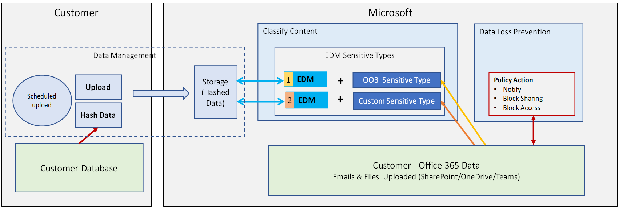
Architecture
Works in three stages for each EDM SIT and pattern
Detect: Identify a candidate for an EDM SIT using the regular SIT on which it is based (using Regex, Keyword or Function)
Match: Query the datastore column for the EDM SIT to find an "exact data match“. Find the matching rows
Associate: If a match is found, look in the text around the match (e.g. 300 characters around) for each of the supporting elements.
Notes:
2

Slide 20
How hashing is used in EDM
To: John Rodriguez
From: noncompliant employee
Mr. Rodriguez:
Can you confirm your SSN is 987-65-4320?
SSN | LastName | DoB | Account#
987-65-4320 | Rodriguez | 2/14/1980 | ABC19838372
078-05-1120 | Smith | 3/22/1957 | BAD38229209
219-09-9999 | Zhang | 11/10/2001 | AAB39383894
To: John Rodriguez
From: noncompliant employee
Mr. Rodriguez:
Can you confirm your SSN is 987-65-4320?
Find candidate
Hash and Upload
987654320
Hash
SSN | LastName | DoB | Account#
56f6e20696e2 | 6f6e2069634 | 0636f6d70617 | 2e4e45542c20
4b177e0db1d | 82517c9053d | 9e7280c96dd | 39750ed0c4e
ebc4103dda7 | 6e206f662073 | 580e00857dd | 3893eb087db
56f6e20696e2 | 6f6e2069634 | 0636f6d70617 | 2e4e45542c20
56f6e20696e2
Table lookup
Proximity search
To John Rodriguez
From noncompliant employee
Mr Rodriguez
Can you confirm
your SSN is
987-65-4320
Cc3c32b2691 a47713800a9 6f6e2069634
D8241a4d291 473acb449e7 56407d12048
10a62951733 6f6e2069634
B997b46306a 3149da056a3 e860e5d9d29
3ad30d65ac2 3aadb7903e7 0c9183be16c 56f6e20696e2
Notes:
2

Slide 21
Deploying EDM

Slide 22
Deploying EDM (short version)
Step 1: Create your schema
From compliance center or via PowerShell
Step 2: Define your sensitive info types
Can be done after step 3 or more likely in parallel
Step 3: Hash and upload your data
Step 4: Profit!
Download the schema file
Clean it up
Use EDM tool to create a table of hashes
Use EDM tool to upload your hashes
Get .csv, .tsv or .psv file
Notes:
3

Slide 23
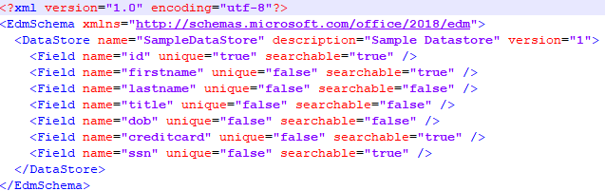
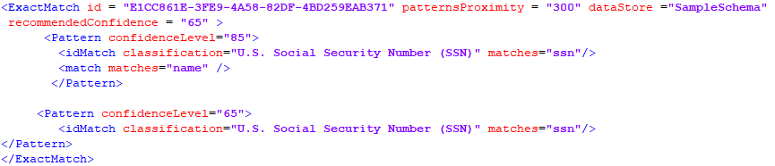
EDM schema and sensitive types, oh my…
EDM Data Schema
(Name & Fields)
Data source name, Fields
EDM Sensitive Type
Searchable Fields
idMatch
Points to an index field. Exact matches of user content with lookup data
EDM Lookup Data
Customer ID (*) | SSN (*) | First Name | Last Name
Match
Target specific column values in the rows mapped to idMatch
Notes:
The EDM lookup data can be info from you line of business application
Notice that certain fields in the db are indexed
Create the EDM schema file, which will be used to define the storage space of the uploaded content. EDM Schema only defines the structure of the lookup data. (Datastore name and fields)
Look up data is hashed and uploaded to the service using the EDM upload agent
You then create the rule pack which defines the sensitive type that will utilize the lookup data. EDM sensitive types uses the lookup data to define matches. Its based on a sensitive type(Classification) and points to a specific field in EDM Schema. The system searches fields based on the EDM sensitive type idMatch. All fields could be used as supporting evidence.
The actual number or pattern we’re looking for is the IDMatch
What we’re looking for in our Proximity windows is the Match.
<ExactMatch id = "E1CC861E-3FE9-4A58-82DF-4BD259EAB371" patternsProximity = "300" dataStore ="SampleSchema" recommendedConfidence = "65" >
<Pattern confidenceLevel="85">
<idMatch classification="U.S. Social Security Number (SSN)" matches="ssn"/>
<match matches="name" />
</Pattern>
<Pattern confidenceLevel="65">
<idMatch classification="U.S. Social Security Number (SSN)" matches="ssn"/>
</Pattern>
</ExactMatch>
In this example match with 85% confidence if both SSN and name associated with record is found. Match with 65% confidence level if only SSN is exact match.

Slide 24
Define EDM Schema (the hard way)
<?xml version="1.0" encoding="utf-8"?> <EdmSchema xmlns="http://schemas.microsoft.com/office/2018/edm"> <DataStore name="SampleDataStore" description="Sample Datastore" version="1"> <Field name="id" unique="true" searchable="true" /> <Field name="firstname" unique="false" searchable="true" /> <Field name="lastname" unique="false" searchable="false" /> <Field name="title" unique="false" searchable="false" /> <Field name="dob" unique="false" searchable="false" /> <Field name="creditcard" unique="false" searchable="true" /> <Field name="ssn" unique="false" searchable="true" /> </DataStore> </EdmSchema>
Sample EDM Schema xml
$edmSchemaXml=Get-Content .\edm.xml -Encoding Byte -ReadCount 0
New-DlpEdmSchema -FileData $edmSchemaXml
Get-DLPEdmSchema
IMPORTANT: Connect to Compliance Center PowerShell session
Notes:
IMPORTANT connect PS to EOP:
$cred = Get-Credential
$s = New-PSSession -ConfigurationName Microsoft.Exchange -ConnectionUri https://compliance.protection.outlook.com/powershell-liveid -Credential $cred -Authentication Basic -AllowRedirection -SessionOption (New-PSSessionOption -SkipCACheck -SkipCNCheck -SkipRevocationCheck)
Import-PSSession $s -AllowClobber
​
Use Cmdlet to create definition of schema for EDM Lookup data. Datastore name and fields will be used for validating the data upload. Also, it would be required as part of EDM Sensitive type definition.
Sample xml for EDM Schema
<?xml version="1.0" encoding="utf-8"?>
<EdmSchema xmlns="http://schemas.microsoft.com/office/2018/edm">
<DataStore name="SampleDataStore" description="Sample Datastore" version="1">
<Field name="id" unique="true" searchable="true" />
<Field name="firstname" unique="false" searchable="true" />
<Field name="lastname" unique="false" searchable="false" />
<Field name="title" unique="false" searchable="false" />
<Field name="dob" unique="false" searchable="false" />
<Field name="creditcard" unique="false" searchable="true" />
<Field name="ssn" unique="false" searchable="true" />
</DataStore>
</EdmSchema>
xml file needs to reflect the lookup data schema – field names can not contain any spaces
$edmSchemaXml=Get-Content .\edm.xml -Encoding Byte -ReadCount 0
New-DlpEdmSchema -FileData $edmSchemaXml
Planned before GA: GUI based way to do this via Sensitive Info types slab in SCC

Slide 25
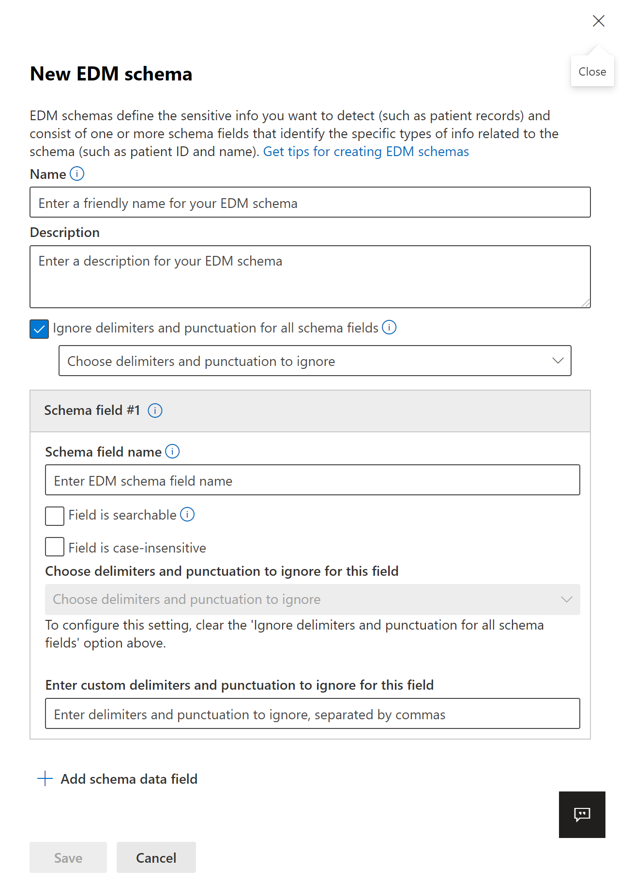
Define EDM Schema (the easier way)
Open the Compliance Center
Navigate to Data Classification
Click on Exact Data Match
Select EDM Schemas, create new schema
Configure the schema
Go drink a coffee (it can take up to one hour for the schema to become available for use)
Notes:
3

Slide 26
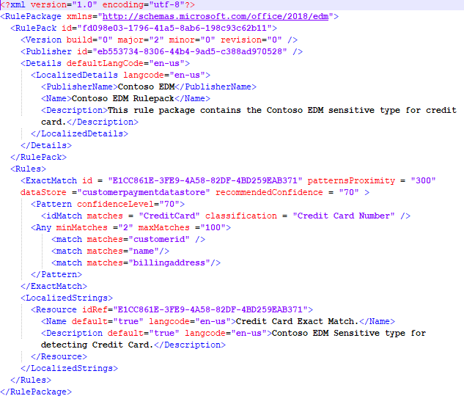
Define EDM Sensitive Information type (the hard way)
RulePack id & ExactMatch id
DataStore
idMatch
Matches
Classification
Match
Resources
idRef
Name & Description
Sample xml for EDM Sensitive type
Notes:
Slide has animation
RulePack id & ExactMatch id: Use New-GUID to generate a GUID.
Datastore: This field specifies EDM lookup data store to be used. You provide a data source name of a configured EDM Schema.
idMatch: This field points to the primary element for EDM.
Matches: Specifies the field to be used in exact lookup. You provide a searchable field name in EDM Schema for the DataStore.
Classification: This field specifies the sensitive type match that triggers EDM lookup. You can provide Name or GUID of an existing built-in or custom classification.
Match: This field points to additional evidence found in proximity of idMatch.
Matches: You provide any field name in EDM Schema for DataStore.
Resource: This section specifies the name and description for sensitive type in multiple locales.
idRef: You provide GUID for ExactMatch id.
Name & des Editing the schema criptions: customize as required.

Slide 27
Upload EDM Rule Pack XML
$rulepack=Get-Content .\rulepack.xml -Encoding Byte -ReadCount 0
New-DlpSensitiveInformationTypeRulePackage -FileData $rulepack
Detail instructions on uploaded the rule pack can be found here:
https://docs.microsoft.com/en-us/office365/securitycompliance/create-a-custom-sensitive-information-type-in-scc-powershell
Use the following cmdlets to validate:
Get-DLPSensitiveInformationTypeRulePackage
Get-DLPSensitiveInformationType
IMPORTANT: Connect PS to Security & Compliance Center

Slide 28
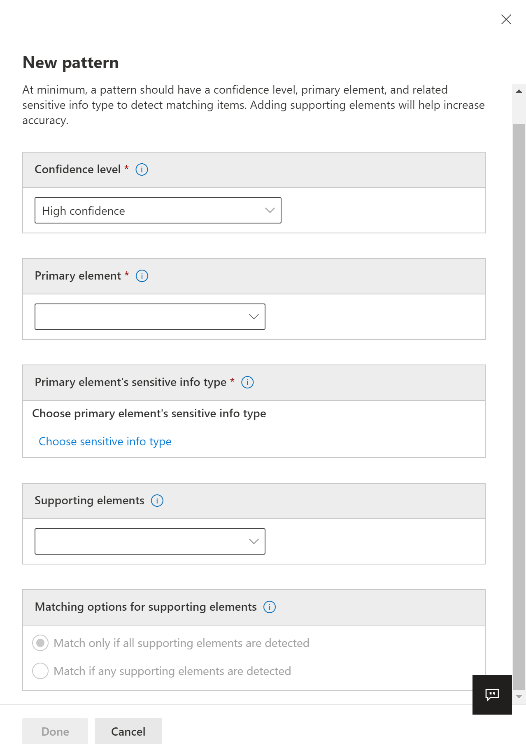
Define an EDM SIT (the slightly easier way)
In the Exact Data Match section of the Compliance Center, select EDM Sensitive Types
Create a new EDM type
Select your schema
Create one or more patterns
Select primary element (column)
Select a SIT that describes it
Select columns to use as secondary element
Define matching rules (e.g. one of n, all, etc.)
Notes:
Slide has animation
RulePack id & ExactMatch id: Use New-GUID to generate a GUID.
Datastore: This field specifies EDM lookup data store to be used. You provide a data source name of a configured EDM Schema.
idMatch: This field points to the primary element for EDM.
Matches: Specifies the field to be used in exact lookup. You provide a searchable field name in EDM Schema for the DataStore.
Classification: This field specifies the sensitive type match that triggers EDM lookup. You can provide Name or GUID of an existing built-in or custom classification.
Match: This field points to additional evidence found in proximity of idMatch.
Matches: You provide any field name in EDM Schema for DataStore.
Resource: This section specifies the name and description for sensitive type in multiple locales.
idRef: You provide GUID for ExactMatch id.
Name & des Editing the schema criptions: customize as required.

Slide 29
Hash and upload your sensitive data
EDM Upload Agent Purpose:
To one-way hash the data to have a file to upload
To Upload file with hashes to the service – where it is stored and ready for lookups
Uploading the file also upload the (automatically generated or manually entered) salt used for hashing
Set up the security group and user account
As a global administrator, go to the admin center create a security group: EDM_DataUploaders.
Add one or more users to the EDM_DataUploaders security group.
Set up the EDM Upload Agent
Download EDM upload agent
https://go.microsoft.com/fwlink/?linkid=2088639
Agent trace logs located:
C:\Program Files\Microsoft\EdmUploadAgent\TraceLogs
Tip: DO NOT install in default folder (program files), use a custom folder, so you do not need admin privileges in the machine to use it.
Notes:
Set up the security group and user account
As a global administrator, go to the admin center (https://admin.microsoft.com) and create a security group called EDM_DataUploaders.
Add one or more users to the EDM_DataUploaders security group. (These users will manage the database of sensitive information.)
Make sure each user who is managing the sensitive data is a local admin on the machine used for the EDM Upload Agent.
Agent Purpose:
To one-way hash the data for upload
Upload Hashed file to the service – where it is stored and ready for lookups
Agent trace logs located:
C:\Program Files\Microsoft\EdmUploadAgent\TraceLogs
Run PS as admin
Upload agent used to create a one way hash of data to be uploaded agent allows customer to indicate which column to base hash on. Hashed data is not available for lookup
EDM Upload Agent should have
o Read access to the file with Lookup data (csv).
o Write access to location for storing hashed data.
o Access to Microsoft Azure Service and ability to write to Azure Storage Blob.

Slide 30
Agent Workflow
Authorize
Download schema
Upload Hashed Data
Confirm successful indexing
Hash Sensitive Data
Notes:
Authorize
Download schema
Hash Sensitive Data (using schema)
Upload Hashed Data
Wait until indexing is completed
List Upload Sessions

Slide 31
Authorize Agent
EdmUploadAgent.exe /Authorize
Example:
Details:
This will prompt for user credentials to authorize the EDM upload agent to act on behalf of the user.
It is recommended to create a separate dedicated user with minimal privileges which can be used for EDM Upload agent.*
Authorization must be done every 30 days (depending on your tenant’s AAD auth token configuration)
Re-run the Authorize command, if any other command fails with authorization errors.
Please note: there’s an Authorize.ps1 script you can use to pass credentials interactively or script so you can pass them as a SecureString
Notes:
*This is any valid user in the tenant. Used only for authentication.
•It is recommended to create a separate dedicated tenant user with minimal privileges which can be used for EDM Upload agent. Privileges need to run?????
Set up the security group and user account
As a global administrator, go to the admin center (https://admin.microsoft.com) and create a security group called EDM_DataUploaders.
Add one or more users to the EDM_DataUploaders security group. (These users will manage the database of sensitive information.)
Make sure each user who is managing the sensitive data is a local admin on the machine used for the EDM Upload Agent.
• This will prompt for user credentials to authorize the EDM upload agent to act on behalf of the user.
Open cmd prompt as admin or you get the error:
Command failed.
Error Type: System.UnauthorizedAccessException
Error Message: Access to the path 'C:\Program Files\Microsoft\EdmUploadAgent\TokenCache.dat' is denied.
EDM Upload Agent should have
o Read access to the file with Lookup data (csv).
o Write access to location for storing hashed data.
o Access to Microsoft Azure Service and ability to write to Azure Storage Blob.
• Re-run the Authorize command, if any other command fails with authorization errors.

Slide 32
Hash and upload Sensitive Data
EdmUploadAgent.exe /CreateHash /DataStoreName <DataStoreName> /DataFile <DataFilePath> /HashLocation <HashedFileLocation>
EdmUploadAgent.exe /UploadHash /DataStoreName <DataStoreName> /HashFile <HashedSourceFilePath> Example:
Details:
DataStoreName: The name of the data store whose schema has already been defined. Hint: same name as the schema.
DataFile: Provide the full path to the data file.
HashLocation: Provide the path to the folder where the hash file should be created.
The naming format of the hash file created is “datafilename.EdmHash”.
Notes:
Errors will be displayed on screen or in the C:\Program files\Microsoft\EdmUploadAgent\TraceLogs

Slide 33
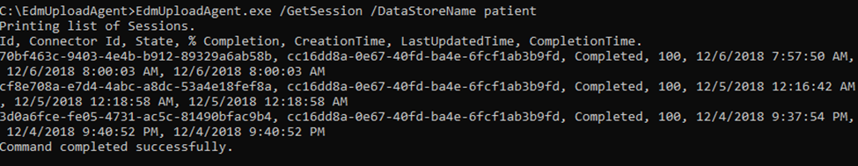
List Upload Sessions and check status
EdmUploadAgent.exe /GetSession /DataStoreName <DataStoreName>
Example:
Details:
Lists all the data uploads done for a specific data store.
Note: until the third column says “Completed” the table is not ready for use. Can take *hours* to complete indexing and replication for large tables.

Slide 34
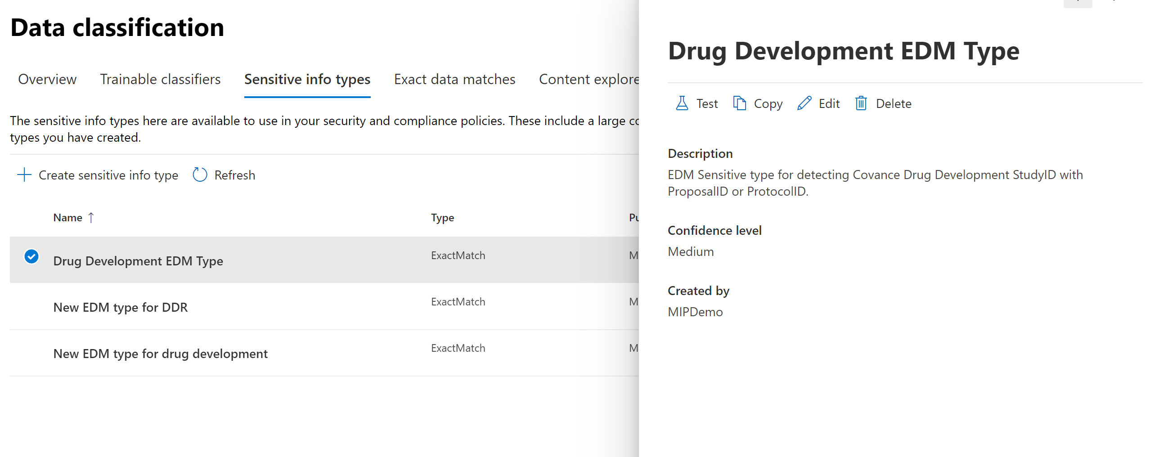
Testing EDM Sensitive Info Type
Classifications, Sensitive info type
Select EDM type
Upload file to test
Notes:
This is in the regular SIT UI, not in the EDM UI!!!
EDM sensitive info type changes take up to *one hour* to be propagated. You might be testing the old version!!!
Notes:
File bug, testing is not enabled and we should see a message indicating this type is not available for testing or it should be grayed out.

Slide 35
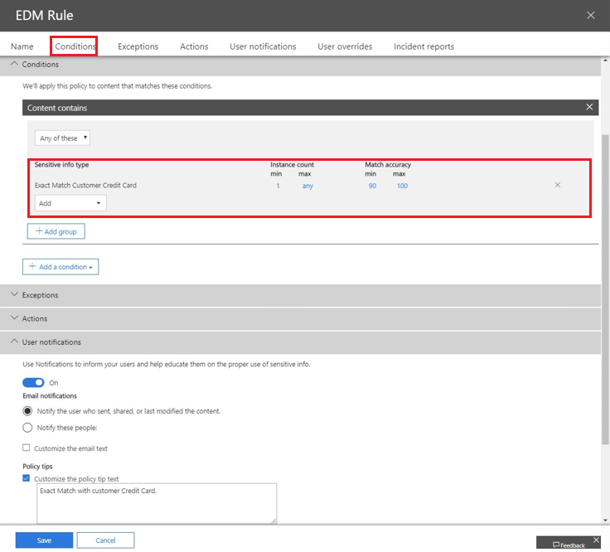
Create a DLP Policy that uses EDM
Use DLP Policy wizard to create policy and corresponding rule
Conditions:
Select the custom EDM sensitive type you just created
Actions:
Only user notification (policy tip) in OWA is supported.
DLP block actions for Exchange, SharePoint and OneDrive planned.
User Notification:
Turn on policy tip
Notes:
*Only policy tip (user notification) in Outlook Web Access is supported. Future Iterations will support DLP block actions for Exchange, SharePoint and OneDrive.
Alternatively can use PS cmdlets new-dlpcompliancepolicy and new-dlpcompliancepolicyrulev2

Slide 36
Sneak peek: new EDM wizard

Slide 37
Before and after
Before:
Identify the structure of your data file and manually define the schema
Create each EDM SIT manually
For each EDM SIT, define each pattern manually by selecting a primary element column and additional evidence columns
Select the matching SIT for each primary evidence element
You need to ensure they match
You need to ensure they aren’t too vague
You may need to use PowerShell for some advanced configurations (more on this later)
Hash and upload sample or production data, wait, test, make adjustments as needed.
After:
Upload a table with sample (fake?) data.
Wizard detects structure and creates schema.
Wizard detects matching SITs for each column and recommends primary elements.
Automatically validates suitability of the matching SITs to exclude most common errors.
Wizard creates EDM SIT with recommended patterns using the SITs.
Trigger SITs are tested against the data as you go.
Notes:
Set up the security group and user account
As a global administrator, go to the admin center (https://admin.microsoft.com) and create a security group called EDM_DataUploaders.
Add one or more users to the EDM_DataUploaders security group. (These users will manage the database of sensitive information.)
Make sure each user who is managing the sensitive data is a local admin on the machine used for the EDM Upload Agent.
Agent Purpose:
To one-way hash the data for upload
Upload Hashed file to the service – where it is stored and ready for lookups
Agent trace logs located:
C:\Program Files\Microsoft\EdmUploadAgent\TraceLogs
Run PS as admin
Upload agent used to create a one way hash of data to be uploaded agent allows customer to indicate which column to base hash on. Hashed data is not available for lookup
EDM Upload Agent should have
o Read access to the file with Lookup data (csv).
o Write access to location for storing hashed data.
o Access to Microsoft Azure Service and ability to write to Azure Storage Blob.

Slide 38
Demo

Slide 39
EDM Best practices

Slide 40
General best practices
Creating your data table:
#1: Use TSV file for your sensitive file, not CSV
If records have commas in values (e.g. street address) or single or double quotes (e.g. O’Connor, John "Hannibal" Smith, etc.) CSV is tricky to get right. TSV rarely causes problems even in these cases.
Surround all columns within double quotes just for redundancy, EDM will strip them out before hashing.
#2: Sanitize your data *automatically*
Identify issues with your table such as corrupt data, fields that need to be divided or surrounded in quotes, etc., and take note of the issues.
Either convince the data owners to fix it up at the source, or build a script to fix the data in bulk, you don’t want to be doing it manually on a weekly basis.
Hashing and importing your data table:
#3: Install the EDM upload agent in a custom folder
If you install it in the default folder you will need admin privileges to run it, since it is under Program Files and the tool writes logs in the same folder.
#4: Validate your data before hashing to detect potential format issues (e.g. missing or extra columns)
EdmUploadAgent.exe /ValidateData /DataFile [data file] /Schema [schema file]
#5: Separate hash and upload processes
The EDM table is extremely sensitive before hashing, do not put it in an internet-facing computer
Hash in an internal machine, delete the original file, copy the hashed file to an internet facing computer and upload from there.
Build a script that does it for you every time!
Notes:
Set up the security group and user account
As a global administrator, go to the admin center (https://admin.microsoft.com) and create a security group called EDM_DataUploaders.
Add one or more users to the EDM_DataUploaders security group. (These users will manage the database of sensitive information.)
Make sure each user who is managing the sensitive data is a local admin on the machine used for the EDM Upload Agent.
Agent Purpose:
To one-way hash the data for upload
Upload Hashed file to the service – where it is stored and ready for lookups
Agent trace logs located:
C:\Program Files\Microsoft\EdmUploadAgent\TraceLogs
Run PS as admin
Upload agent used to create a one way hash of data to be uploaded agent allows customer to indicate which column to base hash on. Hashed data is not available for lookup
EDM Upload Agent should have
o Read access to the file with Lookup data (csv).
o Write access to location for storing hashed data.
o Access to Microsoft Azure Service and ability to write to Azure Storage Blob.

Slide 41
The challenge with the primary element
Each SIT pattern has a primary evidence field
Match candidates will be matched using a SIT first
That field must meet *all* the following conditions:
Marked in the schema as searchable (so it’s indexed)
The values must be “relatively” unique (e.g. have many thousands of possible values)
Date of birth, gender, marital status, first name, nationality, e.g. are all bad candidates
The values must be detectable using a SIT that matches the content precisely
Must detect all values
Not too many false positives (e.g. “four-digit number” will be fond in dates and lots of other things)
Not too common in content (e.g. no more than 100 documents/emails per second with matches on average)
The values in the table must match what’s in content as-is in the documents (e.g. if Full name is listed as Firstname Lastname, it will not match “Lastname, Firstname”).
Find potential matches
Verify they match actual values
Check the surrounding text for a combination of those elements
Retrieve other attributes for the same subject
Flag an EDM match if the conditions are met
Notes:
Set up the security group and user account
As a global administrator, go to the admin center (https://admin.microsoft.com) and create a security group called EDM_DataUploaders.
Add one or more users to the EDM_DataUploaders security group. (These users will manage the database of sensitive information.)
Make sure each user who is managing the sensitive data is a local admin on the machine used for the EDM Upload Agent.
Agent Purpose:
To one-way hash the data for upload
Upload Hashed file to the service – where it is stored and ready for lookups
Agent trace logs located:
C:\Program Files\Microsoft\EdmUploadAgent\TraceLogs
Run PS as admin
Upload agent used to create a one way hash of data to be uploaded agent allows customer to indicate which column to base hash on. Hashed data is not available for lookup
EDM Upload Agent should have
o Read access to the file with Lookup data (csv).
o Write access to location for storing hashed data.
o Access to Microsoft Azure Service and ability to write to Azure Storage Blob.

Slide 42
Key considerations for the “trigger” SIT
The SIT used for a primary element must not be too frequently present in content
E.g. not in every document or email generated.
Keep in mind that document metadata and text in email headers are also included in matching!
Every email and document has multiple dates, email addresses, GUIDs, IP addresses, names, etc.. Make sure you are not using a SIT that will detect those!
SIT might also be improperly firing because it is finding “substrings”, e.g. \d{6} will detect six consecutive digits within another string, like a GUID, \b\d{6}\b will only detect six digits alone.
The SIT must match the whole string as present in the table and nothing else
Or else, it will produce a hash that’s different from what is stored.
E.g. [a-z]+\@[a-z]+\.[a-z]+ will detect only the highlighted part in the email address: john.smith@company.co.uk
A regex starting and/or ending with \s will include the space character as part of the match! Use \b instead.
The SIT must match with and without any optional delimiters
The “ignored delimiters” option only strips the characters after a candidate is detected
E.g. if Ignored delimiters is set to “-”, the string 123-45-6789 will be stripped of the dash before hashing, but if the SIT is looking for \d{9} it won’t even flag it as a candidate.
Notes:
Set up the security group and user account
As a global administrator, go to the admin center (https://admin.microsoft.com) and create a security group called EDM_DataUploaders.
Add one or more users to the EDM_DataUploaders security group. (These users will manage the database of sensitive information.)
Make sure each user who is managing the sensitive data is a local admin on the machine used for the EDM Upload Agent.
Agent Purpose:
To one-way hash the data for upload
Upload Hashed file to the service – where it is stored and ready for lookups
Agent trace logs located:
C:\Program Files\Microsoft\EdmUploadAgent\TraceLogs
Run PS as admin
Upload agent used to create a one way hash of data to be uploaded agent allows customer to indicate which column to base hash on. Hashed data is not available for lookup
EDM Upload Agent should have
o Read access to the file with Lookup data (csv).
o Write access to location for storing hashed data.
o Access to Microsoft Azure Service and ability to write to Azure Storage Blob.

Slide 43
Question: why do we need a SIT to match EDM
Matching each individual string in a document against a table with tens of millions of rows is incredibly wasteful.*
It would waste >99.99% of the lookups in things that could never match. Humans would never do that, neither should computers.
If you are trying to find out if a document includes your SSN, do you skim through it until you find a long number first, or you compare each individual word against your SSN digits?
Traditionally this problem was solved by throwing hardware at it. I.e. you pay for inefficiency in CPUs, energy, etc.
In the cloud, you would pay for it in higher service prices. .
To avoid this, we ask you to tell us “how does the data we are looking for look like?”
A SIT is the perfect method for doing that!
* For number nerds like me, the effort to compare all strings in a document with n characters against a table with m rows amounts to [n²+n]/2 hashing computations and [n²+n]/2*m comparisons. Looking up the text in this PPT against an indexed table with 100 million rows would require 3 billion comparisons. And companies generate A LOT of content.
Notes:
Set up the security group and user account
As a global administrator, go to the admin center (https://admin.microsoft.com) and create a security group called EDM_DataUploaders.
Add one or more users to the EDM_DataUploaders security group. (These users will manage the database of sensitive information.)
Make sure each user who is managing the sensitive data is a local admin on the machine used for the EDM Upload Agent.
Agent Purpose:
To one-way hash the data for upload
Upload Hashed file to the service – where it is stored and ready for lookups
Agent trace logs located:
C:\Program Files\Microsoft\EdmUploadAgent\TraceLogs
Run PS as admin
Upload agent used to create a one way hash of data to be uploaded agent allows customer to indicate which column to base hash on. Hashed data is not available for lookup
EDM Upload Agent should have
o Read access to the file with Lookup data (csv).
o Write access to location for storing hashed data.
o Access to Microsoft Azure Service and ability to write to Azure Storage Blob.

Slide 44
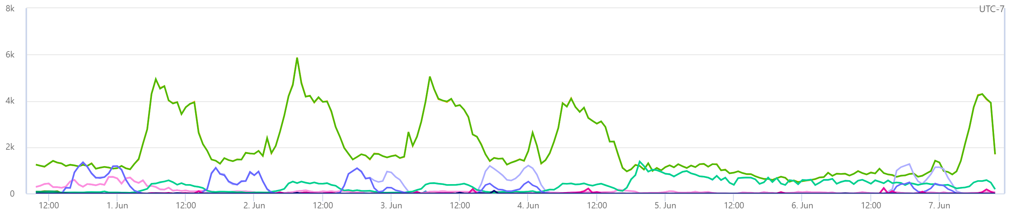
What happens if you choose the wrong SIT
If the wrong SIT is used to trigger EDM matching:
1) It may cause missed detections because the system is too busy processing random strings that won’t match.
If a SIT causes an average of more than ~100 matches per second in your tenant, it is likely a bad candidate to use as trigger for a primary element (limit is enforced at ~15000 documents with matches per minute)
Be aware of peaks in load, plan for the worst.
If there’s significant throttling, we may contact you.
2) If each value in the primary element column is repeated across too many rows, it may cause processing to timeout before all rows are analyzed.
E.g. if you have a “birth year” column, there could be lots of dates in each document for matching, returning tens of thousands of matching rows each, all evidence columns for each need to be compared to the hashes of all words surrounding each of those dates.
3) An improperly defined SIT might fail to detect valid matches (e.g. an account number SIT might not accept numbers with dashes or in lower case), so EDM doesn’t get to try them against the table.
4) An “unbound” regex might match a substring or superstring of what’s in the table, so hashes won’t match. E.g. a partial email address.
5) It might match something that is spelled out or ordered differently from what’s in the table, so the hashes won’t agree.
IF you get something from this webinar, let it be NOT TO USE a “wildcard” regex as a SIT trigger!!!! E.g.:
\w+ (matches every string)
\b\w+\b (matches every word)
[A-Za-z0-9]+ (matches any string)
\d+ (matches any number of any length)
NOTE: if an EDM SIT is throttled in your tenant, ALL EDM SITS ARE THROTTLED IN YOUR TENANT. So even an unused EDM SIT might cause EDM to not be functional. Don’t leave broken test EDM SITs around.
Notes:
Set up the security group and user account
As a global administrator, go to the admin center (https://admin.microsoft.com) and create a security group called EDM_DataUploaders.
Add one or more users to the EDM_DataUploaders security group. (These users will manage the database of sensitive information.)
Make sure each user who is managing the sensitive data is a local admin on the machine used for the EDM Upload Agent.
Agent Purpose:
To one-way hash the data for upload
Upload Hashed file to the service – where it is stored and ready for lookups
Agent trace logs located:
C:\Program Files\Microsoft\EdmUploadAgent\TraceLogs
Run PS as admin
Upload agent used to create a one way hash of data to be uploaded agent allows customer to indicate which column to base hash on. Hashed data is not available for lookup
EDM Upload Agent should have
o Read access to the file with Lookup data (csv).
o Write access to location for storing hashed data.
o Access to Microsoft Azure Service and ability to write to Azure Storage Blob.

Slide 45
Exercise: define the primary element
LastName | Firstname | SSN | DoB | Account# | Address
Rodriguez | John | 987-65-4320 | 2/14/1980 | ABC19838372 | 24827 NE 23rd St., Redmond, WA
Smith | Edward | 078-05-1120 | 3/22/1957 | BAD38229209 | 873 Newport Ct., Kent, WA
Zhang | Li | 219-09-9999 | 11/10/2001 | AAB39383894 | 9982 High Road Circle, Springfield, CO
First question: which permutations are needed?
E.g. Last Name and (SSN or Account # or Address), SSN and DoB, Account # and (DoB, Address or SSN).
Depends on your business needs.
Let’s say you need to detect those three combinations above.
What’s the ideal set of primary elements?
Must be identifiable via a SIT
Excludes first name, DoB and Address, at least without using advanced techniques to be discussed later.
Must be relatively unique
Excludes first name and DoB
Must not be present in too great numbers unless it is what I need to detect
Excludes dates, last names and first names
Ideal options are SSN and Account#. All permutations except for “Last Name and Address” include one of these two.
We’ll discuss what to do for that specific combination later.
Notes:
Set up the security group and user account
As a global administrator, go to the admin center (https://admin.microsoft.com) and create a security group called EDM_DataUploaders.
Add one or more users to the EDM_DataUploaders security group. (These users will manage the database of sensitive information.)
Make sure each user who is managing the sensitive data is a local admin on the machine used for the EDM Upload Agent.
Agent Purpose:
To one-way hash the data for upload
Upload Hashed file to the service – where it is stored and ready for lookups
Agent trace logs located:
C:\Program Files\Microsoft\EdmUploadAgent\TraceLogs
Run PS as admin
Upload agent used to create a one way hash of data to be uploaded agent allows customer to indicate which column to base hash on. Hashed data is not available for lookup
EDM Upload Agent should have
o Read access to the file with Lookup data (csv).
o Write access to location for storing hashed data.
o Access to Microsoft Azure Service and ability to write to Azure Storage Blob.

Slide 46
Exercise: choosing the right SIT
LastName | Firstname | SSN | DoB | Account# | Address
Rodriguez | John | 987-65-4320 | 2/14/1980 | ABC198383 | 24827 NE 23rd St., Redmond, WA
Smith | Edward | 078-05-1120 | 3/22/1957 | BAD382292 | 873 Newport Ct., Kent, WA
Zhang | Li | 219-09-9999 | 11/10/2001 | AAB393838 | 9982 High Road Circle, Springfield, CO
For SSN we *could* use the built-in SSN
But then it would require a word like SSN to be present in the document AND within 300 characters of the SSN value.
In large tables, that may not be true or only true for the first few rows.
Solution: clone and edit the SSN SIT and remove the requirement for additional evidence (keywords).
For Account #, we will have to create a regex-based SIT.
So, \W+, right?
NO! That will cause too many matches to process and potentially saturate our ability to detect sensitive data. Use a custom regex, e.g.: [A-Za-z]{3}\d{6}
But that will also detect something like b3afd387344d (something that may be part of a GUID, for example). So ALWAYS delimit your regexes: \b[A-Za-z]{3}\d{6}\b
Notes:
Set up the security group and user account
As a global administrator, go to the admin center (https://admin.microsoft.com) and create a security group called EDM_DataUploaders.
Add one or more users to the EDM_DataUploaders security group. (These users will manage the database of sensitive information.)
Make sure each user who is managing the sensitive data is a local admin on the machine used for the EDM Upload Agent.
Agent Purpose:
To one-way hash the data for upload
Upload Hashed file to the service – where it is stored and ready for lookups
Agent trace logs located:
C:\Program Files\Microsoft\EdmUploadAgent\TraceLogs
Run PS as admin
Upload agent used to create a one way hash of data to be uploaded agent allows customer to indicate which column to base hash on. Hashed data is not available for lookup
EDM Upload Agent should have
o Read access to the file with Lookup data (csv).
o Write access to location for storing hashed data.
o Access to Microsoft Azure Service and ability to write to Azure Storage Blob.

Slide 47
So I can only use columns that match a simple regex?
NO!
First off, you may not need to use it as a primary element, and use the tricky column as “additional evidence” with another column as primary.
If you *have* to use it as a primary element:
You can use a regular expression with additional conditions built-in:
E.g. an email address regex that excludes those in the TO and CC lines:
(?m)(?<!((From|To|CC): ([a-zA-Z0-9. <>@\.\-\(\);])*))([a-zA-Z0-9.-]+\@[a-zA-Z0-9.]+\.[a-zA-Z]{​​​2,15}​​​)\b
You can use a “Loose” regular expression with keywords:
E.g. \b\d{6,9}\b, but with the keywords “account number”, “account ID”, or “acct#” nearby.
You can use multiple regexes (in different patterns or as a combined regex joined by an OR condition)
E.g. you want to detect account numbers in multiple different formats: ABC12345, A12345XY, 12345678901234 , A1B2C3D123456, and more
Bad option: single regex pattern that detects all of them (and more): [A-Z\d]{8,14}
Better option: combine regexes for each format via “|”:
\b([A-Z]{3}\d{5})|([A-Z]\d{5}\[XY]{2}|\d{14}|([A-Z]\d){4}\d{5})\b
But more importantly: SIT <> REGEX, there are other options you can consider:
Named entities
Dictionaries
Divide a column in separate elements
Notes:
Set up the security group and user account
As a global administrator, go to the admin center (https://admin.microsoft.com) and create a security group called EDM_DataUploaders.
Add one or more users to the EDM_DataUploaders security group. (These users will manage the database of sensitive information.)
Make sure each user who is managing the sensitive data is a local admin on the machine used for the EDM Upload Agent.
Agent Purpose:
To one-way hash the data for upload
Upload Hashed file to the service – where it is stored and ready for lookups
Agent trace logs located:
C:\Program Files\Microsoft\EdmUploadAgent\TraceLogs
Run PS as admin
Upload agent used to create a one way hash of data to be uploaded agent allows customer to indicate which column to base hash on. Hashed data is not available for lookup
EDM Upload Agent should have
o Read access to the file with Lookup data (csv).
o Write access to location for storing hashed data.
o Access to Microsoft Azure Service and ability to write to Azure Storage Blob.

Slide 48
Using Named Entity Recognition with EDM
What is NER?
Algorithmic classifiers that detect specific types of entities:
All full names
All physical locations
Physical locations in different countries
“All last names” and others on the roadmap
Etc.
Match based on format, context and internal dictionaries.
NER is not often used alone. Typically used to enhance accuracy of rules that look for PII
e.g. an SSN *and someone’s name*
Can also be used with EDM as a trigger SIT for the corresponding primary element, e.g. to match a “Full Name” column.
Main limitation: content like names and addresses may be written in a different way than how NER captures the match. E.g. it might capture a full address including province and country, while your table might include only the street address.
Notes:
Set up the security group and user account
As a global administrator, go to the admin center (https://admin.microsoft.com) and create a security group called EDM_DataUploaders.
Add one or more users to the EDM_DataUploaders security group. (These users will manage the database of sensitive information.)
Make sure each user who is managing the sensitive data is a local admin on the machine used for the EDM Upload Agent.
Agent Purpose:
To one-way hash the data for upload
Upload Hashed file to the service – where it is stored and ready for lookups
Agent trace logs located:
C:\Program Files\Microsoft\EdmUploadAgent\TraceLogs
Run PS as admin
Upload agent used to create a one way hash of data to be uploaded agent allows customer to indicate which column to base hash on. Hashed data is not available for lookup
EDM Upload Agent should have
o Read access to the file with Lookup data (csv).
o Write access to location for storing hashed data.
o Access to Microsoft Azure Service and ability to write to Azure Storage Blob.

Slide 49
Using Dictionaries with EDM
Dictionaries? Isn’t EDM better?
EDM SIT triggered by a dictionary: the best of both worlds!
Use dictionary to find candidates, use EDM to find the exact matches to combined columns.
But what about dictionary sizes? What if I have millions of records to protect?
You might have 100M customers, but there aren’t 100M last names.
Pro tip: sort the dictionary before upload (makes compression more efficient).
Bonus tip: You might also want to include additional conditions in the dictionary-based SIT.
 | Dictionaries | EDM
Table size | ~100K rows (1MB compressed text) | 100M rows
Accuracy | Single value match | Multi-column match
Case sensitivity | Case insensitive | Case sensitive or insensitive
Privacy | Need to upload the data to Microsoft | Only need to supply salted hashes of data
Max detection rate | Not limited | 100s per second
Last name
Reese
Connor
Silberman
Traxler
All last names
Connor
Reese
Silberman
Traxler
Upload as dictionary
First name | Last name | SSN
Kye | Reese | 111-11-1111
John | Connor | 983-87-3339
SARAH | CONNOR | 292-09-2866
Peter | Silberman | 283-33-2114
Ed | Traxler | 091-22-9384
Deduplicate
Hash and upload
Firstname | Lastname | SSN
56f6e20696e2 | 6f6e2069634 | 0636f6d70617
4b177e0db1d | 82517c9053d | 9e7280c96dd
ebc4103dda7 | 6e206f662073 | 580e00857dd
56f6e20696e2 | 6f6e2069634 | 0636f6d70617
4b177e0db1d | 82517c9053d | 9e7280c96dd
Notes:
Set up the security group and user account
As a global administrator, go to the admin center (https://admin.microsoft.com) and create a security group called EDM_DataUploaders.
Add one or more users to the EDM_DataUploaders security group. (These users will manage the database of sensitive information.)
Make sure each user who is managing the sensitive data is a local admin on the machine used for the EDM Upload Agent.
Agent Purpose:
To one-way hash the data for upload
Upload Hashed file to the service – where it is stored and ready for lookups
Agent trace logs located:
C:\Program Files\Microsoft\EdmUploadAgent\TraceLogs
Run PS as admin
Upload agent used to create a one way hash of data to be uploaded agent allows customer to indicate which column to base hash on. Hashed data is not available for lookup
EDM Upload Agent should have
o Read access to the file with Lookup data (csv).
o Write access to location for storing hashed data.
o Access to Microsoft Azure Service and ability to write to Azure Storage Blob.

Slide 50
(Very) advanced scenario: Parsing/splitting a column
What if you have to detect complex elements such as street addresses?
E.g. “29833 NE 29th St., Redmond, WA, 98052, USA”
Problems:
Too many different addresses to fit in a dictionary
Address might not be spelled out that same way in a document
Solution:
Parse the column in parts
Define SITs (dictionary or regex) for each
Define EDM columns for each based on the SIT
E.g.:
29833 → Street number regex-based SIT
NE 29th St. → Street name dictionary-based SIT (requires a match to street number and city or ZIP nearby)
Redmond → City name dictionary-based SIT
98052 → Zip code regex-based SIT
Then create an EDM SIT pattern for “Customer street address” that uses the street name as primary evidence and a combination of the others plus some other PII as secondary (e.g. street name and number plus first name).
Notes:
Set up the security group and user account
As a global administrator, go to the admin center (https://admin.microsoft.com) and create a security group called EDM_DataUploaders.
Add one or more users to the EDM_DataUploaders security group. (These users will manage the database of sensitive information.)
Make sure each user who is managing the sensitive data is a local admin on the machine used for the EDM Upload Agent.
Agent Purpose:
To one-way hash the data for upload
Upload Hashed file to the service – where it is stored and ready for lookups
Agent trace logs located:
C:\Program Files\Microsoft\EdmUploadAgent\TraceLogs
Run PS as admin
Upload agent used to create a one way hash of data to be uploaded agent allows customer to indicate which column to base hash on. Hashed data is not available for lookup
EDM Upload Agent should have
o Read access to the file with Lookup data (csv).
o Write access to location for storing hashed data.
o Access to Microsoft Azure Service and ability to write to Azure Storage Blob.

Slide 51
Structured process for defining SIT patterns
Start by listing all the possible combinations of the fields in a table.
Hide all those that have few valid values (e.g. gender, “marital status”, etc.) since they don’t add value to the detection.
Mark all combinations that are of interest (example below is simplified, complex conditions might require more nuanced markings).
Color code those rows and columns that have a structured, easy to detect format, that can be detected using a SIT.
Any combination that involves a colored row or column, can use that field as a primary element. You can remove any column that only has marks in colored cells.
If there are remaining combinations that don’t involve a colored row or column, choose the row that is simplest to identify via a dictionary or NER and flag them as well.
Mark all the combinations involved as covered by using that column as primary element.
Repeat the last step until there are no combinations not covered by a primary element that can be detected via a SIT.
 | Last name | First name | National ID | Account # | Drivers license | Street Address | Date of birth
Last name |  |  | X | X | X | X | X
First name |  |  | X |  |  | X
National ID | X | X |  | X | X | X | X
Account number | X |  | X |  | X | X | X
Drivers license | X |  | X | X |  | X | X
Street Address | X | X | X | X | X
Date of birth | X |  | X | X | X
 | Last name | First name | National ID | Account # | Drivers license | Street Address | Date of birth
Last name |  |  | X | X | X | X | X
First name |  |  | X |  |  | X
National ID | X | X |  | X | X | X | X
Account number | X |  | X |  | X | X | X
Drivers license | X |  | X | X |  | X | X
Street Address | X | X | X | X | X
Date of birth | X |  | X | X | X
 | Last name | First name | National ID | Account # | Drivers license | Street Address | Date of birth
Last name |  |  | X | X | X | X | X
First name |  |  | X |  |  | X
National ID | X | X |  | X | X | X | X
Account number | X |  | X |  | X | X | X
Drivers license | X |  | X | X |  | X | X
Street Address | X | X | X | X | X
Date of birth | X |  | X | X | X
 | Last name | First name | National ID | Account # | Drivers license | Street Address | Date of birth
Last name |  |  | X | X | X | X | X
First name |  |  | X |  |  | X
National ID | X | X |  | X | X | X | X
Account number | X |  | X |  | X | X | X
Drivers license | X |  | X | X |  | X | X
Street Address | X | X | X | X | X
Date of birth | X |  | X | X | X
Notes:
Set up the security group and user account
As a global administrator, go to the admin center (https://admin.microsoft.com) and create a security group called EDM_DataUploaders.
Add one or more users to the EDM_DataUploaders security group. (These users will manage the database of sensitive information.)
Make sure each user who is managing the sensitive data is a local admin on the machine used for the EDM Upload Agent.
Agent Purpose:
To one-way hash the data for upload
Upload Hashed file to the service – where it is stored and ready for lookups
Agent trace logs located:
C:\Program Files\Microsoft\EdmUploadAgent\TraceLogs
Run PS as admin
Upload agent used to create a one way hash of data to be uploaded agent allows customer to indicate which column to base hash on. Hashed data is not available for lookup
EDM Upload Agent should have
o Read access to the file with Lookup data (csv).
o Write access to location for storing hashed data.
o Access to Microsoft Azure Service and ability to write to Azure Storage Blob.

Slide 52
Multi-token additional evidence columns
Situation example : I created an EDM SIT that uses “company name” as additional evidence, and some rows don’t match.
Cause: by default, EDM matches additional evidence against *individual words* in the text surrounding a primary element match
So it can’t match “multi-word” terms (e.g. compound last names, street names, phone numbers with spaces, etc.)
E.g.: if the street name column for the matched person includes “Calder Cyn Rd.” and the text in a document includes “Sarah J. Connor lives in 309 Calder Cyn Rd.”, the system will compare the hashes of “lives”, “in”, “309”, “Calder”, “Cyn” and “Rd.” against the hash of “Calder Cyn Rd.” and none of them will produce a match.
Solution: assign a SIT to the additional evidence columns when you refer to them in the EDM SIT pattern, just like when you do it for primary evidence!
How? That’s not in the UI!
Indeed, but coming soon.
Today, you have to edit the XML for the EDM SIT, e.g.:
<ExactMatch id="cb664342-1b60-4451-a98f-68b378ce6f62" patternsProximity="300" dataStore=“T-800" >
<Pattern confidenceLevel="75">
<idMatch matches="SSN" classification="U.S. Social Security Number (SSN)" />
<Any minMatches=“1" maxMatches=“3">
<match matches=“Lastname" />
<match matches=“AddressStreet" classification=“Street Names Dictionary”/>
<match matches="Phone" />
</Any>
</Pattern>
</ExactMatch>
See https://docs.microsoft.com/en-us/microsoft-365/compliance/sit-modify-a-custom-sensitive-information-type-in-powershell for details.
Be aware: throttling limits *do not* apply to this SIT, so the SIT can be more “relaxed”.
Notes:
Set up the security group and user account
As a global administrator, go to the admin center (https://admin.microsoft.com) and create a security group called EDM_DataUploaders.
Add one or more users to the EDM_DataUploaders security group. (These users will manage the database of sensitive information.)
Make sure each user who is managing the sensitive data is a local admin on the machine used for the EDM Upload Agent.
Agent Purpose:
To one-way hash the data for upload
Upload Hashed file to the service – where it is stored and ready for lookups
Agent trace logs located:
C:\Program Files\Microsoft\EdmUploadAgent\TraceLogs
Run PS as admin
Upload agent used to create a one way hash of data to be uploaded agent allows customer to indicate which column to base hash on. Hashed data is not available for lookup
EDM Upload Agent should have
o Read access to the file with Lookup data (csv).
o Write access to location for storing hashed data.
o Access to Microsoft Azure Service and ability to write to Azure Storage Blob.

Slide 53
EDM Special scenarios

Slide 54
Specific cases of columns as primary evidence
We will discuss:
Full names
Last names
Street addresses
Account number / Medical Record Numbers with mixed patterns
Date of birth
Devices
Notes:
Set up the security group and user account
As a global administrator, go to the admin center (https://admin.microsoft.com) and create a security group called EDM_DataUploaders.
Add one or more users to the EDM_DataUploaders security group. (These users will manage the database of sensitive information.)
Make sure each user who is managing the sensitive data is a local admin on the machine used for the EDM Upload Agent.
Agent Purpose:
To one-way hash the data for upload
Upload Hashed file to the service – where it is stored and ready for lookups
Agent trace logs located:
C:\Program Files\Microsoft\EdmUploadAgent\TraceLogs
Run PS as admin
Upload agent used to create a one way hash of data to be uploaded agent allows customer to indicate which column to base hash on. Hashed data is not available for lookup
EDM Upload Agent should have
o Read access to the file with Lookup data (csv).
o Write access to location for storing hashed data.
o Access to Microsoft Azure Service and ability to write to Azure Storage Blob.

Slide 55
Full names as primary element
Main challenge: names can look like regular words, and can have two, three, four or more words, some punctuation and even symbols in them.
Don’t use a regular expression, e.g. “[A-Z][a-z]+( [A-Z][a-z]+)”
It will cause lots of false positives and result in throttling and missed detections.
Once a regular expression matches some text, it won’t use it again for further matches, for example the regex above applied to the phrase “Patient John Smith was examined by Dr. Peter Robinson” will match Patient John and Peter Robinson, but not John Smith.
Consider first: if you can use another column to use as primary. Most often, names only need to be detected in combination with other “harder” identifiers such as SSN or account numbers.
If you must use full names as primary evidence, evaluate using the “All Full Names” Named Entity Recognition classifier, it’s the easiest option.
Limitations:
Might not detect all names, depending on context, syntax and how uncommon a name may be, so there’s some risk of false negatives.
Some languages are not yet supported.
Might detect a name in a different format than what’s entered in the table (e.g. Smith, John instead of John Smith).
Alternative: divide full name column in first and last names and use dictionaries as we will discuss later.
Note: use the same techniques if you need to use full names as secondary elements in an EDM pattern.
Notes:
Set up the security group and user account
As a global administrator, go to the admin center (https://admin.microsoft.com) and create a security group called EDM_DataUploaders.
Add one or more users to the EDM_DataUploaders security group. (These users will manage the database of sensitive information.)
Make sure each user who is managing the sensitive data is a local admin on the machine used for the EDM Upload Agent.
Agent Purpose:
To one-way hash the data for upload
Upload Hashed file to the service – where it is stored and ready for lookups
Agent trace logs located:
C:\Program Files\Microsoft\EdmUploadAgent\TraceLogs
Run PS as admin
Upload agent used to create a one way hash of data to be uploaded agent allows customer to indicate which column to base hash on. Hashed data is not available for lookup
EDM Upload Agent should have
o Read access to the file with Lookup data (csv).
o Write access to location for storing hashed data.
o Access to Microsoft Azure Service and ability to write to Azure Storage Blob.

Slide 56
Last names as primary element
Main challenge: Compound or multiple last names make detection with a regex hard.
ALSO don’t use a regular expression, e.g. “[A-Z][a-z]+( [A-Z][a-z]+)”
Same recommendation as for full names: avoid if possible.
NER for All Last Names will be available soon, with similar caveats as for All Full Names.
Most effective option: use the de-duplicated dictionary-based SIT approach suggested before:
Real world example: hospital patient list with over ten million patients.
After de-duplication, less than 100K unique last names (including a few typos)
Sorted and compressed it used 260KB, fitting well within a keyword dictionary.
Also consider same technique for using last names as additional evidence.
Last name
Reese
Connor
Silberman
Traxler
Upload as dictionary
All last names
Connor
Reese
Silberman
Traxler
First name | Last name | SSN
Kye | Reese | 111-11-1111
John | Connor | 983-87-3339
SARAH | CONNOR | 292-09-2866
Peter | Silberman | 283-33-2114
Ed | Traxler | 091-22-9384
Deduplicate
Hash and upload
Firstname | Lastname | SSN
56f6e20696e2 | 6f6e2069634 | 0636f6d70617
4b177e0db1d | 82517c9053d | 9e7280c96dd
ebc4103dda7 | 6e206f662073 | 580e00857dd
56f6e20696e2 | 6f6e2069634 | 0636f6d70617
4b177e0db1d | 82517c9053d | 9e7280c96dd
Notes:
Set up the security group and user account
As a global administrator, go to the admin center (https://admin.microsoft.com) and create a security group called EDM_DataUploaders.
Add one or more users to the EDM_DataUploaders security group. (These users will manage the database of sensitive information.)
Make sure each user who is managing the sensitive data is a local admin on the machine used for the EDM Upload Agent.
Agent Purpose:
To one-way hash the data for upload
Upload Hashed file to the service – where it is stored and ready for lookups
Agent trace logs located:
C:\Program Files\Microsoft\EdmUploadAgent\TraceLogs
Run PS as admin
Upload agent used to create a one way hash of data to be uploaded agent allows customer to indicate which column to base hash on. Hashed data is not available for lookup
EDM Upload Agent should have
o Read access to the file with Lookup data (csv).
o Write access to location for storing hashed data.
o Access to Microsoft Azure Service and ability to write to Azure Storage Blob.

Slide 57
Street addresses as primary element
Main challenges:
Street addresses may involve different formats across the world, or even within a country
Street addresses may be written differently (e.g. St., vs Street, Northeast vs. NE)
Street addresses may or may not include things like ZIP, city, state, etc.
Consider using All Physical Addresses (or country-specific physical addresses) NER classifier if addresses are consistently written in full.
Might consider using a complex regular expression if your country is not supported by NER, but beware of same challenges with partial addresses, addresses typed with different elements, etc.
Most effective method if you must use physical addresses as a primary element: use the parse/split method described before:
29833 → Street number regex-based SIT and Street number column in schema
NE 29th St. → Street name dictionary-based SIT and Street name column in schema
Redmond → Cities dictionary-based SIT and City column in schema
98052 → Zip code regex-based SIT and ZIP code column in schema
(parsing of the address column to separate in multiple columns can be scripted without much trouble)
Then use an EDM pattern that requires street name as the primary element and the other columns as secondary elements within e.g. 50 characters.
Note: some “street names” may be common words, so to avoid triggering too frequently, add requirements for matches to the street number, city and/or ZIP code regex or dictionary matches nearby so the SIT only matches likely addresses.
Notes:
Set up the security group and user account
As a global administrator, go to the admin center (https://admin.microsoft.com) and create a security group called EDM_DataUploaders.
Add one or more users to the EDM_DataUploaders security group. (These users will manage the database of sensitive information.)
Make sure each user who is managing the sensitive data is a local admin on the machine used for the EDM Upload Agent.
Agent Purpose:
To one-way hash the data for upload
Upload Hashed file to the service – where it is stored and ready for lookups
Agent trace logs located:
C:\Program Files\Microsoft\EdmUploadAgent\TraceLogs
Run PS as admin
Upload agent used to create a one way hash of data to be uploaded agent allows customer to indicate which column to base hash on. Hashed data is not available for lookup
EDM Upload Agent should have
o Read access to the file with Lookup data (csv).
o Write access to location for storing hashed data.
o Access to Microsoft Azure Service and ability to write to Azure Storage Blob.

Slide 58
MRN, Account #, custom ID as primary elements
Typically composed of numbers and letters, or just numbers.
Challenges:
Low numbers sometimes valid and may cause false positives. E.g. some hospitals started with MRN #1.
Mixed formats: due to M&A, many formats may have accumulated over time.
Don’t: use a regex like \w+, or even \b[A-Za-z0-9]{4,10}\b, will lead to throttling.
First impulse is to say “there’s no pattern”, but there’s *always* a pattern.
Best approach: divide and conquer.
Take the first number and define a pattern that matches it. Filter the table to exclude values that match that regex (sample script in slide notes) and repeat the process, joining each regex to the previous one with a “|”, until all values are covered.
E.g.:
Additonal consideration: if some of the patterns are too “easy” (e.g. Four digit numbers), split them out and require either specific values from a dictionary (if few valid ones) or additional evidence (e.g. Keywords required for any MRN under 10000).
03184383044
F1038800841
194343313443
334494388444
314331383444
14148809841
134901111441441
F4148319443
\b\d{11}\b
+
F1038800841
194343313443
334494388444
314331383444
134901111441441
F4148319443
\b\d{11}|F\d{10}\b
+
194343313443
334494388444
134901111441441
\b\d{11,12}|F\d{10}\b
+
134901111441441
\b\d{11,12}|\d{14}|F\d{10}\b
Notes:
strInFile=WScript.Arguments(0)
Set objFSO = CreateObject("Scripting.FileSystemObject")
Set objInFile = objFSO.OpenTextFile(strInFile, 1)
Set objFilter = CreateObject("VBScript.RegExp")
Set fso = CreateObject ("Scripting.FileSystemObject")
Set stdout = fso.GetStandardStream (1)
objFilter.Global = True
objFilter.Pattern = WScript.Arguments(1)
stdout.WriteLine "This will go to standard output."
Do Until objInFile.AtEndOfStream
strFileRow = objInFile.ReadLine
if objFilter.Test(strFileRow) then
strPMatch = objFilter.Replace(strFileRow,"")
if not strPMatch = "" then
stdOut.WriteLine "Partial Mismatch in " + strFileRow + ": " + strPMatch
' else
' stdOut.WriteLine "Match: " + strFileRow
end if
else
stdOut.WriteLine "Mismatch: " + strFileRow
end if
Loop
objOutFile.Close
objInFile.Close

Slide 59
Date of birth as primary element
Don’t.
Notes:
Set up the security group and user account
As a global administrator, go to the admin center (https://admin.microsoft.com) and create a security group called EDM_DataUploaders.
Add one or more users to the EDM_DataUploaders security group. (These users will manage the database of sensitive information.)
Make sure each user who is managing the sensitive data is a local admin on the machine used for the EDM Upload Agent.
Agent Purpose:
To one-way hash the data for upload
Upload Hashed file to the service – where it is stored and ready for lookups
Agent trace logs located:
C:\Program Files\Microsoft\EdmUploadAgent\TraceLogs
Run PS as admin
Upload agent used to create a one way hash of data to be uploaded agent allows customer to indicate which column to base hash on. Hashed data is not available for lookup
EDM Upload Agent should have
o Read access to the file with Lookup data (csv).
o Write access to location for storing hashed data.
o Access to Microsoft Azure Service and ability to write to Azure Storage Blob.

Slide 60
Date of birth as primary element
Seriously, don’t.
Why not dates?
It’s not PII unless it is attached to a person. 12/20/1965 is someone’s birthday, am I leaking something here if I don’t say whose?
Dates are everywhere. The average email has 20 of them (including headers). You WILL get throttled.
They are written in many different formats. You will get false negatives.
Same birth date is shared by hundreds of thousands of people. EDM processing will timeout and miss matches.
Use anything else that’s more uniquely identifying for primary element, and only use birth dates as secondary elements if needed.
What about using birth date as additional element then? I need a SIT, right?
You *CAN* use a regex for birthdays as additional evidence, but be sure to exclude dates that are obviously not birth dates (dates in the future or too recent if you aren’t a hospital, dates followed by timestamps, dates in the Sent row of an email, etc.).
E.g. \b([012]?\d|3(0|1))(\/|-|\.)([012]?\d|3(0|1))(\/|-|\.)(19\d{​​​2}​​​|20(0\d)|\d{​​​2}​​​)(?! \d{​​​1,2}​​​:\d{​​​2}​​​(:\d{​​​2}​​​)?)\b
Or
(?<!^Sent: (Monday|Tuesday|Wednesday|Thursday|Friday|Saturday|Sunday), )(January|February|March|April|May|June|July|August|September|October|November|December) (1|2|3)?\d(,| of)? (1|2)\d{​​​​​​​​​​​​3}​​​​​​​​​​​​(?: \d{​​​​​​​​​​​​1,2}​​​​​​​​​​​​:\d{​​​​​​​​​​​​1,2}​​​​​​​​​​​​( (AM|PM))?)?$
BUT keep in mind dates might be entered in different formats in documents. You might have to include multiple versions as additional columns, e.g. D/MM/YYYY, D/M/YY, YYYY/MM/DD, etc.
Notes:
Set up the security group and user account
As a global administrator, go to the admin center (https://admin.microsoft.com) and create a security group called EDM_DataUploaders.
Add one or more users to the EDM_DataUploaders security group. (These users will manage the database of sensitive information.)
Make sure each user who is managing the sensitive data is a local admin on the machine used for the EDM Upload Agent.
Agent Purpose:
To one-way hash the data for upload
Upload Hashed file to the service – where it is stored and ready for lookups
Agent trace logs located:
C:\Program Files\Microsoft\EdmUploadAgent\TraceLogs
Run PS as admin
Upload agent used to create a one way hash of data to be uploaded agent allows customer to indicate which column to base hash on. Hashed data is not available for lookup
EDM Upload Agent should have
o Read access to the file with Lookup data (csv).
o Write access to location for storing hashed data.
o Access to Microsoft Azure Service and ability to write to Azure Storage Blob.

Slide 61
Device info as primary element
You can use EDM for device names, IDs, IP address, MAC addresses, etc.
But all those are tricky, since they are part of every email header!
Also, server names can be common words.
Solution:
Exclude all names that are part of a message header, e.g. use a regex that excludes matches before “MIME-Version” using a negative lookahead.
Exclude all names in special lines like “Received: from” using a negative lookbehind.
Exclude all known email server names using a dictionary as a negative condition (use MaxMatches=0 in the SIT XML)
If device names follow a strict pattern, use a regex.
For server names, use a dictionary, unless you have hundreds of thousands of servers they should fit.
For IP addresses, MAC addresses, etc., you can use a regex, but make sure to exclude all those in email headers.
If using a pattern for something like an unformatted MAC address or IP address, make sure you properly surround your regex with \b, to avoid detecting substrings of things like GUIDs.
Test the SIT exhaustively, and add exclusions to your logic as necessary to reduce unintended matches before you configure an EDM SIT based on it.
Notes:
Set up the security group and user account
As a global administrator, go to the admin center (https://admin.microsoft.com) and create a security group called EDM_DataUploaders.
Add one or more users to the EDM_DataUploaders security group. (These users will manage the database of sensitive information.)
Make sure each user who is managing the sensitive data is a local admin on the machine used for the EDM Upload Agent.
Agent Purpose:
To one-way hash the data for upload
Upload Hashed file to the service – where it is stored and ready for lookups
Agent trace logs located:
C:\Program Files\Microsoft\EdmUploadAgent\TraceLogs
Run PS as admin
Upload agent used to create a one way hash of data to be uploaded agent allows customer to indicate which column to base hash on. Hashed data is not available for lookup
EDM Upload Agent should have
o Read access to the file with Lookup data (csv).
o Write access to location for storing hashed data.
o Access to Microsoft Azure Service and ability to write to Azure Storage Blob.

Slide 62
What if none of those things work?
What if I can’t use a regex?
What if there’s no NER for what I want to detect?
What if I have too many values to put in a dictionary?
Get creative.
E.g.
Write a script that looks for the longest or most infrequent word in each string in the table, de-duplicate them, and put them in a dictionary and in a separate column, use *that* as the primary or secondary element instead of the full value. If not enough, repeat the process for the *second* longest or most infrequent word and use as secondary evidence to reduce FPs.
This can be hard, but there are very few cases where there is no viable solution.
If stuck, post your question on Yammer. The community should be able to help.

Slide 63
Appendix: collateral reading (if you are masochist)
Sensitive info type definitions: https://aka.ms/sensitiveinfotypes
Sensitive info type XML syntax for manual edit of SITs: https://docs.microsoft.com/en-us/microsoft-365/compliance/sit-get-started-exact-data-match-create-rule-package
Configuring EDM: https://docs.microsoft.com/en-us/microsoft-365/compliance/sit-get-started-exact-data-match-based-sits-overview
Troubleshooting EDM: https://docs.microsoft.com/en-us/microsoft-365/compliance/sit-get-started-exact-data-match-test
Third party regular expression resources:
https://regexr.com/ (great tool for learning by trial and error, though it doesn’t strictly support the Microsoft syntax)
http://regexstorm.net/tester (great for troubleshooting, supports the exact Microsoft implementation of regex)
http://www.rexegg.com/ (extremely thorough regex tutorial)

